Slide 1
Spatial Ecology and Modeling Part 3: Population Ecology
Tiffany Knight
Tiffany.knight@idiv.de
Martin Andrzejak
martin.andrzejak@idiv.de
Aldo Compagnoni
aldo.compagnoni@idiv.de
Aspen Workman
autumn.aspen.1030@gmail.com
Konrad Adler
konrad.adler@student.uni-halle.de

Slide 2
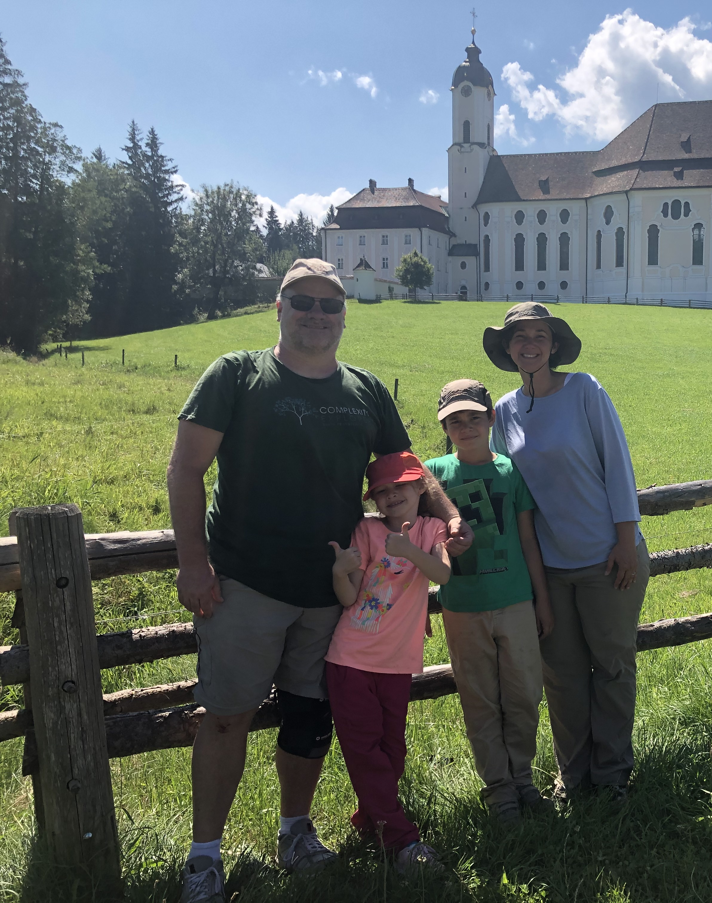
Tiffany Knight
I am originally from Florida, USA.
I was a professor in the USA from 2005-2015.
In February, 2016 I started a professorship in Spatial Interaction Ecology at MLU

Slide 3
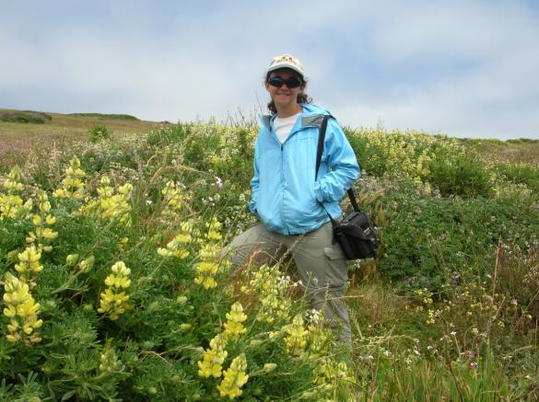
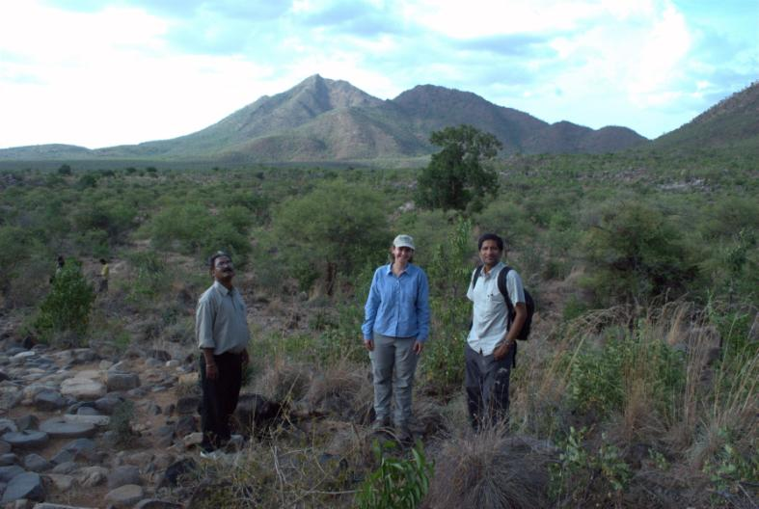
I am a Population Ecologist.
I focus on the effects of global change factors on the population dynamics of plants.
My field research is currently in the USA (California, Hawaii), India, and many locations in Europe (Germany, Romania, Finland, Czech Republic)
I also strive to synthesize the state of our knowledge on these topics using meta-analysis.

Slide 4
I am passionate about
Producing scientific knowledge that is necessary to adapt to climate change and secure biodiversity.
Creating a scientific environment that is inclusive and supportive and working towards cultural change in academia.

Slide 5
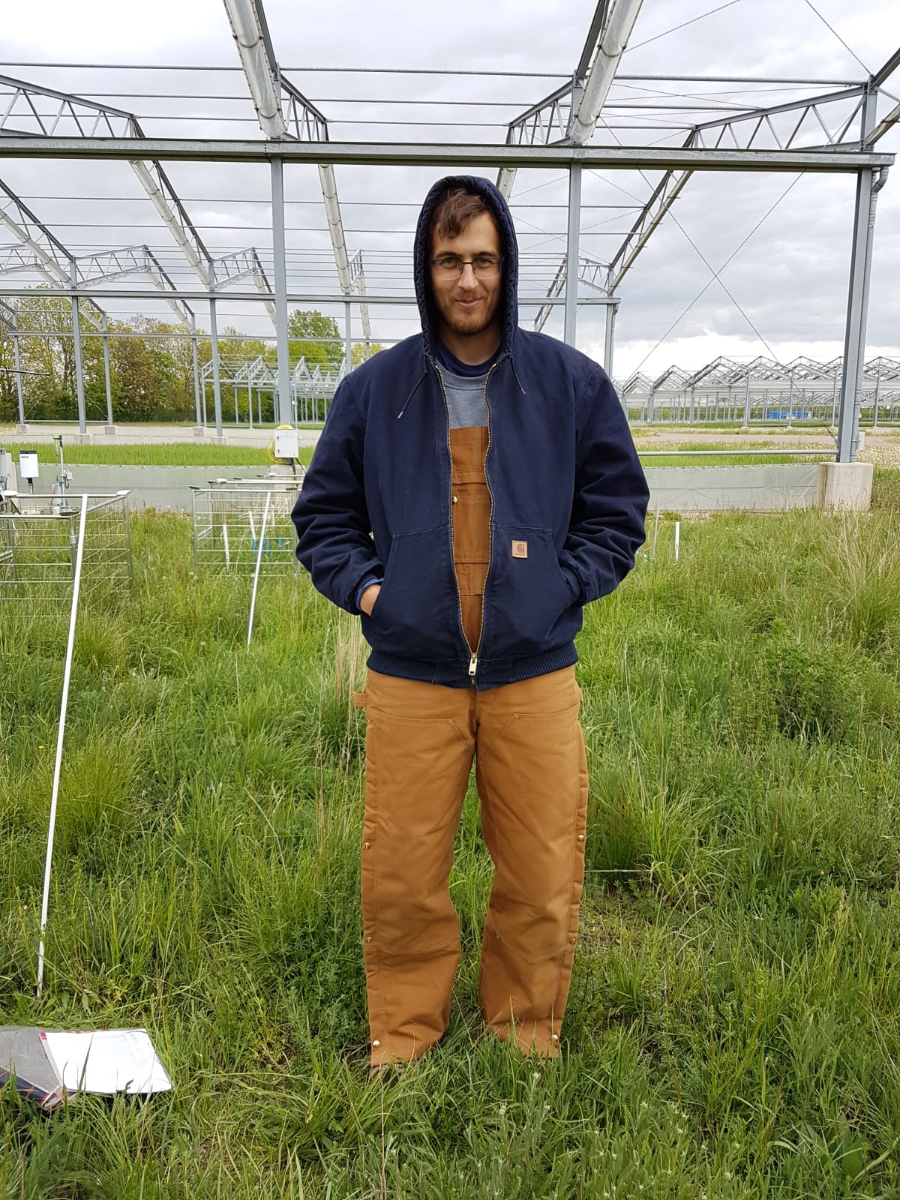
Martin Andrzejak
I am from Sondershausen, Thüringen
I was just like everyone here a student at MLU
In February 2018 I started my PhD with Tiffany
I love R and fieldwork!

Slide 6
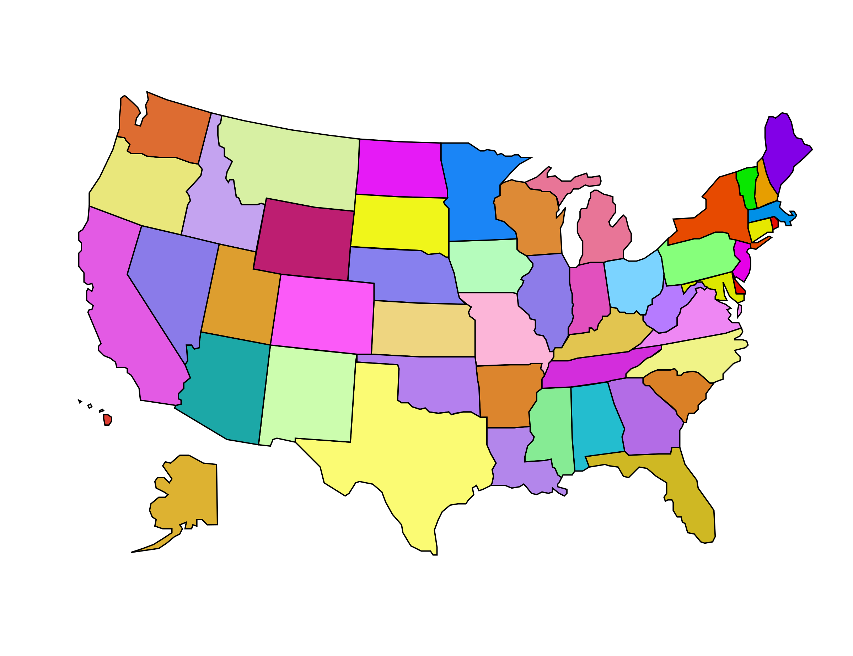
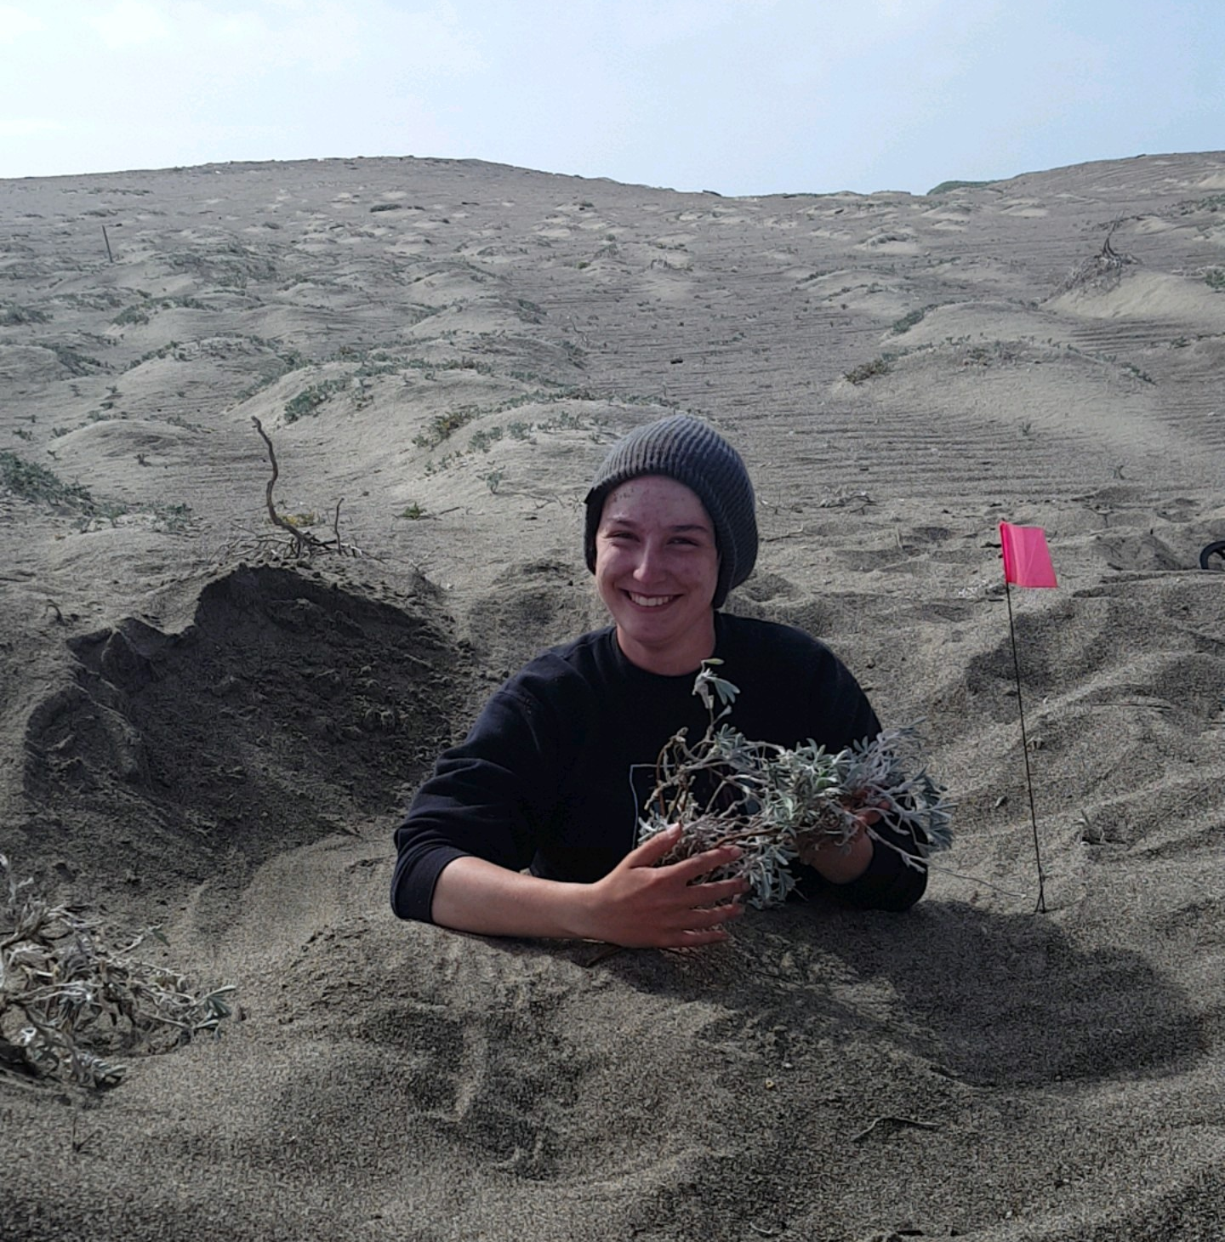
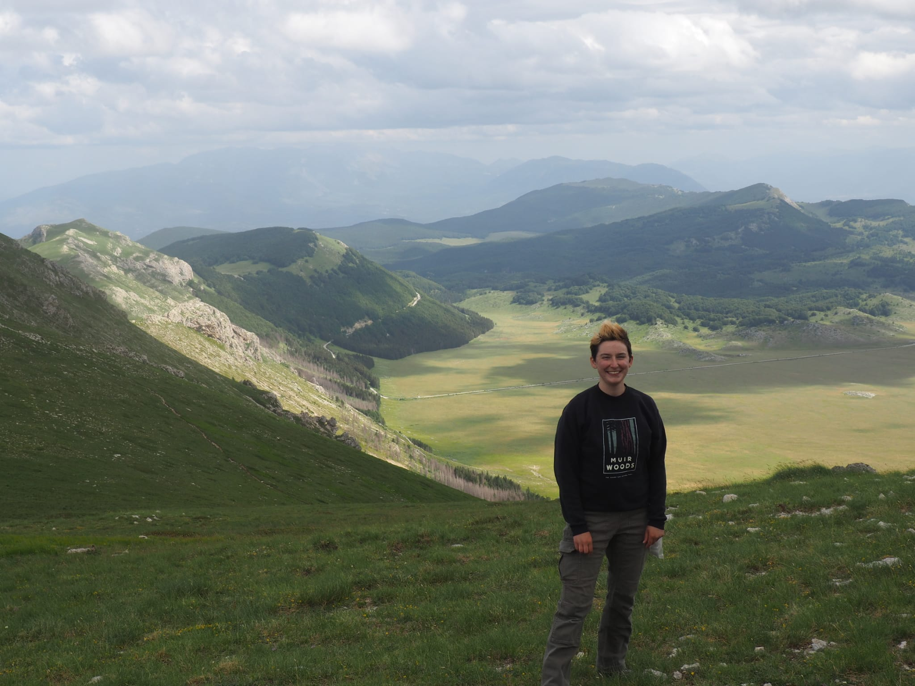
Aspen Workman
I am from St. Louis, Missouri, USA
Bachelor at University of Louisville in Kentucky, USA
2nd year Master student in International Biodiversity Sciences program
First started working for Tiffany 2014-2017
I love botany, bees, and R!

Slide 7
Student introductions

Slide 8
Grading
50% report and 50% exam
Knight section is 25% of grade
Henrique Pereira 33%
Stan Harpole 25%
Ingolf Kühn 17%
The grade for this part of the course is:
Computer lab 1: 10%
Computer lab 2: 10%
Computer lab 3: 10%
Presentation on question/design of project: 5%
Presentation on project: 10%
Submit questions on papers: 5%
Take-home Exam: 50%

Slide 9
Hopes and Fears

